Slide 1


Slide 2

Getting started with Microsoft Intune and PowerShell

Slide 3



$Presenter = @{
Name = ’Nickolaj Andersen’
Company = ’TrueSec’
Title = ’Principal Consultant’
ContactInfo = @{
Mail = ’nickolaj.andersen@truesec.se’
Blog = ’www.scconfigmgr.com’
Twitter = ’@NickolajA’
}
Awards = @(’MVP’, ’PowerShell Hero’)
}

Slide 4









Slide 5







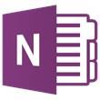
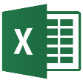
Microsoft Graph
trendingAround
Shared with me
CONVERSATIONS
manager
USER
workingWith
registeredOwner
DEVICES
EVENTS
modifiedBy
TASKS
memberOf
workingWith
TASKS
GROUPS
createdBy
NOTES
MESSAGES
NOTES
FILES

Slide 6
Microsoft Intune in Azure
Device Compliance
Manage Apps
More...
Intune UX
Microsoft Graph API https://graph.microsoft.com
Policy Provider
App Provider
App Provider
Policy Provider
App Provider
More…
Intune
Service

Slide 7
Accessing Microsoft Graph API with PowerShell
One endpoint
One access token
All data
Native app
https://graph.microsoft.com
Intune
Azure AD
more…

Slide 8
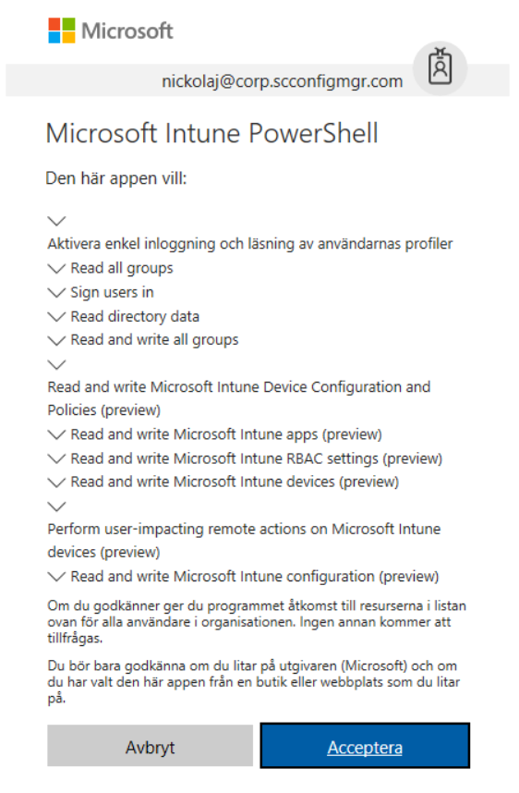
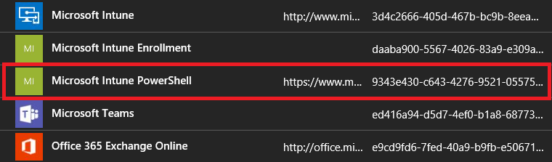
Azure AD app registration for Intune
Microsoft PowerShell Intune
Access to Intune resources
Scripted admin consent
Custom Azure AD app registration
Access to all resources
Manual admin consent

Slide 9
Azure AD app registration
Notes:
# Use MSIntuneAutomation app to show how to add permissions and grant access to Graph API
# Demo-01.ps1 for admin consent

Slide 10
Exchange data between client and server
JavaScript Object Notation (JSON)
Lightweight data-interchange format using text
Language independent
A collection of name and value pairs
PowerShell supports JSON format

Slide 11
Sample JSON format
{
"userPrincipalName": "nickolaj@tenant.onmicrosoft.com",
"accountEnabled": true,
"passwordProfile": {
"password": "Password123",
"forceChangePasswordNextLogin": false
},
"mailNickname": "nickolaj",
"usageLocation": "SE",
"displayName": "Nickolaj Andersen"
}

Slide 12
What is Microsoft Graph API

Slide 13
Resource query format
Graph URL
(Static)
Version
(v1.0 or Beta)
Specific entity resource, such as users, groups, devices, etc.
https://graph.microsoft.com/beta/users?$filter=userPrincipalName eq 'user@tenant.onmicrosoft.com'
Optional query arguments: $filter, $top

Slide 14
Filtering and limiting response
Graph API supports query parameters to customize the response
Name | Description | Example
$filter | Filters results | https://graph.microsoft.com/v1.0/users?$filter=startswith(givenName,'J')
$top | Limits results | https://graph.microsoft.com/v1.0/users?$top=500
https://msdn.microsoft.com/en-us/library/azure/ad/graph/howto/azure-ad-graph-api-supported-queries-filters-and-paging-options

Slide 15
Microsoft Graph – Query methods
GET
Provides the ability to pull data from Microsoft Graph
Data returned in JSON format
POST
Provides the ability to POST / ADD data into Microsoft Graph
Data sent to the service in JSON format
PATCH
Provides the ability to PATCH / UPDATE resource properties
Data sent to the service in JSON format
DELETE
Provides the ability to DELETE individual resources
Data response from service in JSON

Slide 16
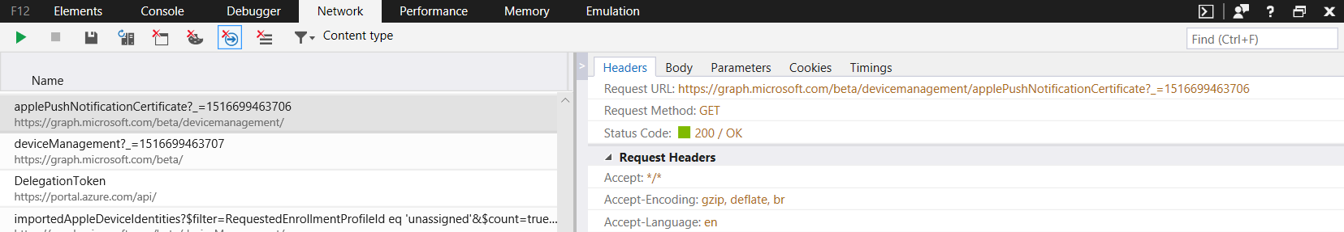
Graph API calls using Developer Mode
Browser with Developer Mode support (F12)
Discover calls for resources through the Intune on Azure portal
Substitute for beta documentation reference

Slide 17
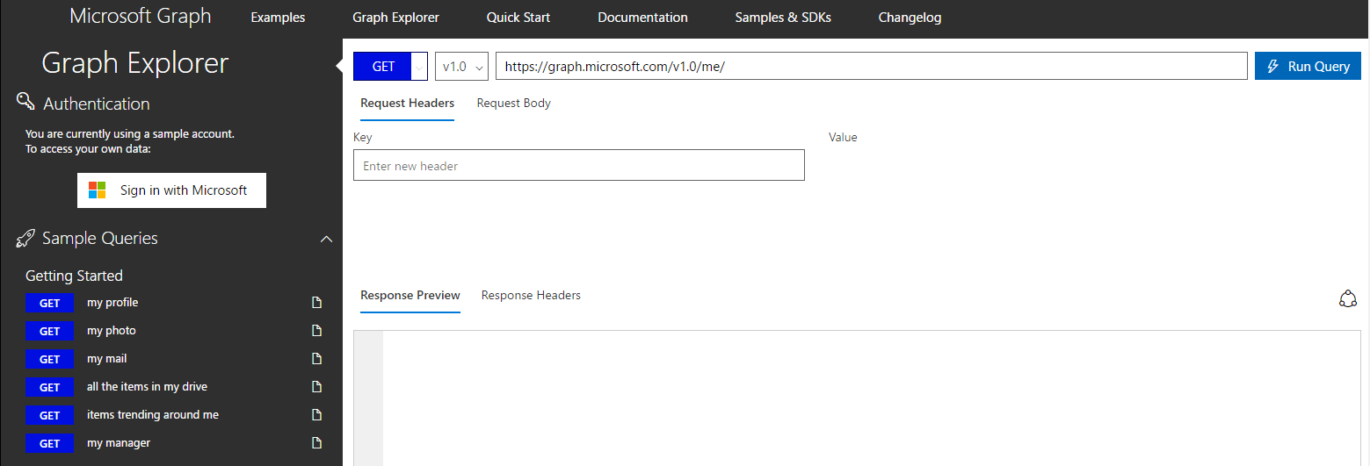
Microsoft Graph Explorer
Explore Microsoft Graph API
Supports Beta and v1.0 APIs
Shortcuts to samples and history
Access sample account or your own data

Slide 18
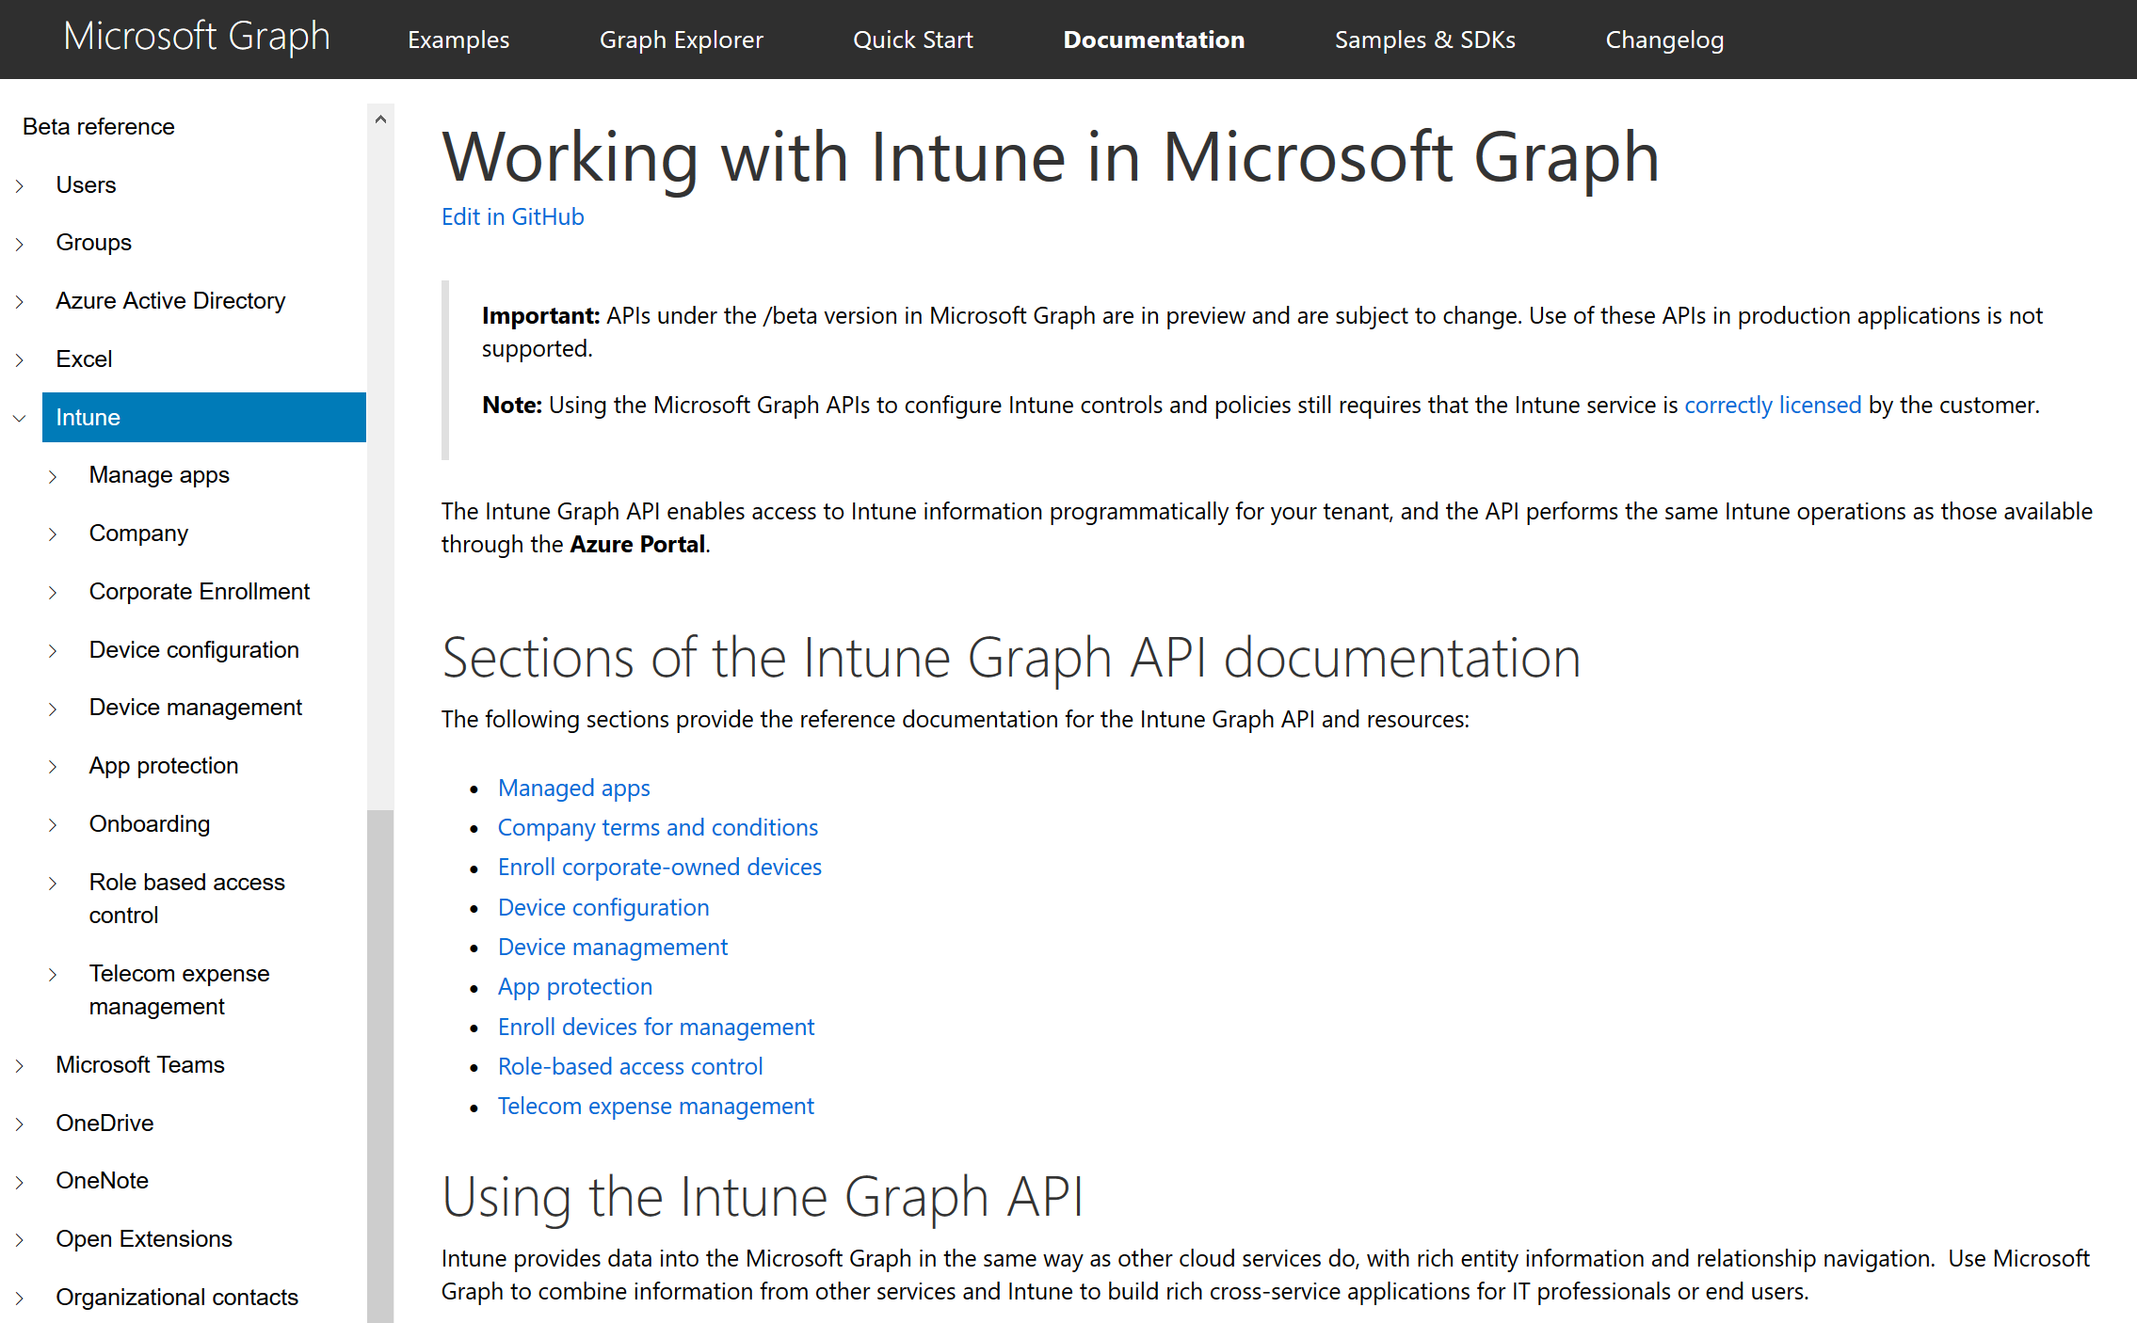
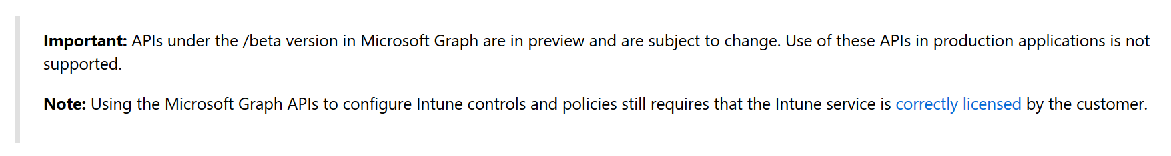
Microsoft Graph for Intune documentation
https://developer.microsoft.com/en-us/graph/docs/api-reference/beta/resources/intune_graph_overview

Slide 19
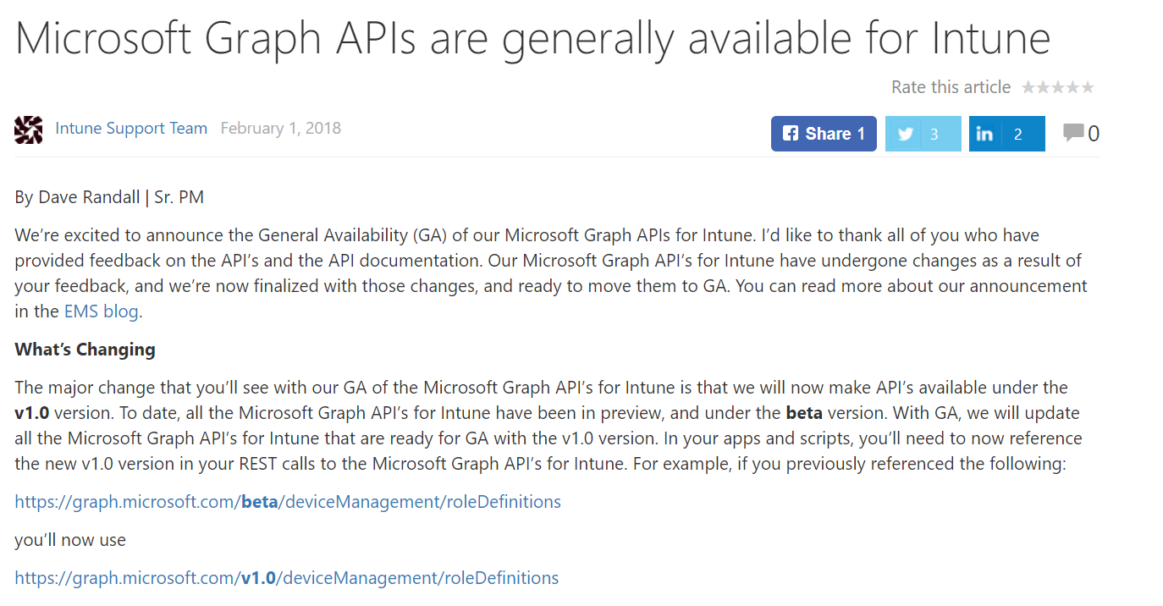
Beta API goes General Availability
https://blogs.technet.microsoft.com/intunesupport/2018/02/01/microsoft-graph-apis-are-generally-available-for-intune/

Slide 20
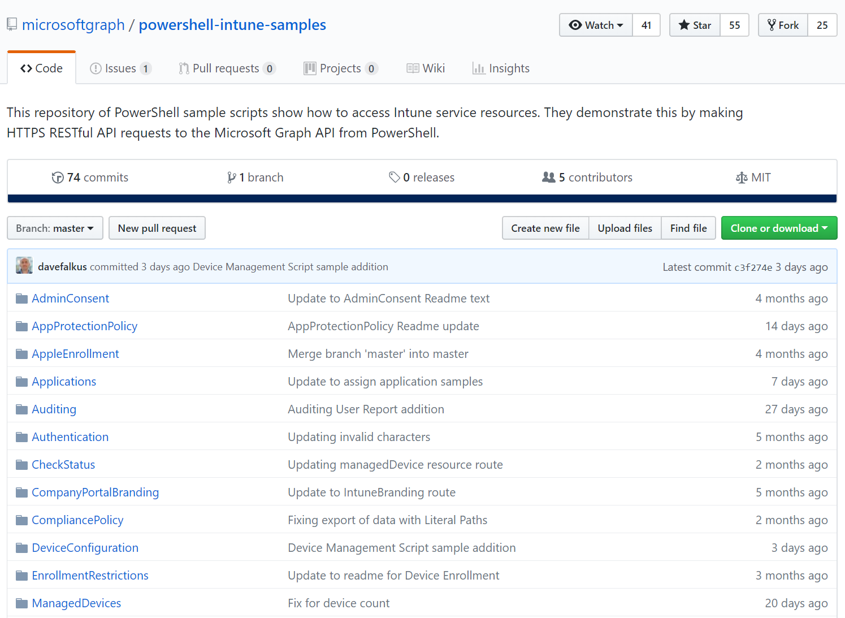
Microsoft Intune PowerShell samples

Slide 21
Authentication
Notes:
# Use MSIntuneAutomation app to show how to add permissions and grant access to Graph API
# Demo-01.ps1

Slide 22
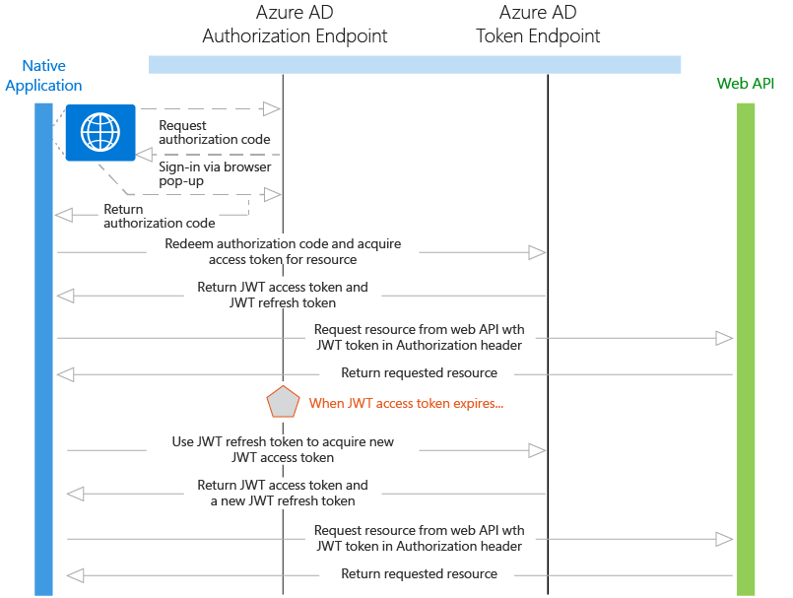
Authentication and access tokens

Slide 23
Authentication and access token
Notes:
# Demo-02.ps1
# Script-TemplateWithAuth.ps1

Slide 24


Intune in Azure – Paging
All Microsoft Graph queries are subject to paging
Request odata.nextLink
Native App
Send GET request
Microsoft Graph
Send GET request
3
4
6
Send 1000 JSON objects
5
Receive 1000 JSON objects
Intune Service
If exists send
response back to
get data
7
Issue Access token
Check if
odata.nextLink
exists
2
8
1
Graph Response:
odata.nextLink
Authenticate User
Azure AD
Notes:
https://github.com/microsoftgraph/powershell-intune-samples/tree/master/Paging

Slide 25
Handle paging
Notes:
# Demo-03.ps1

Slide 26

Schedule automated tasks
Determine scheduled task method
On-premise Task Scheduler
Azure Automation
Acquire authentication token
Safely stored credentials
Run automation script

Slide 27
Intune and Azure Automation

Slide 28
Resources to get started
Documentation (v1.0 and beta)
https://developer.microsoft.com/en-us/graph/docs/api-reference/beta/resources/intune_graph_overview
https://developer.microsoft.com/en-us/graph/docs/api-reference/v1.0/resources/intune_graph_overview
Microsoft PowerShell Intune samples
https://github.com/microsoftgraph/powershell-intune-samples
Community PowerShell modules
https://www.powershellgallery.com/packages/PSIntuneAuth/1.1.0
https://www.powershellgallery.com/packages/MSGraphAPI/0.3.8

Slide 29
Q&A
Slides and demos from the conference will be available at github.com/nordicinfrastructureconference/2018 (bit.ly/2y7JhA3)

